Slide 1

EcoChain
Energy Efficient Blockchain!
Team Vector
Notes:
To use this title animation slide with a new image simply 1) move the top semi-transparent shape to the side, 2) delete placeholder image, 3) click on the picture icon to add a new picture, 4) Move semi-transparent shape back to original position, 5) Update text on slide.

Slide 2
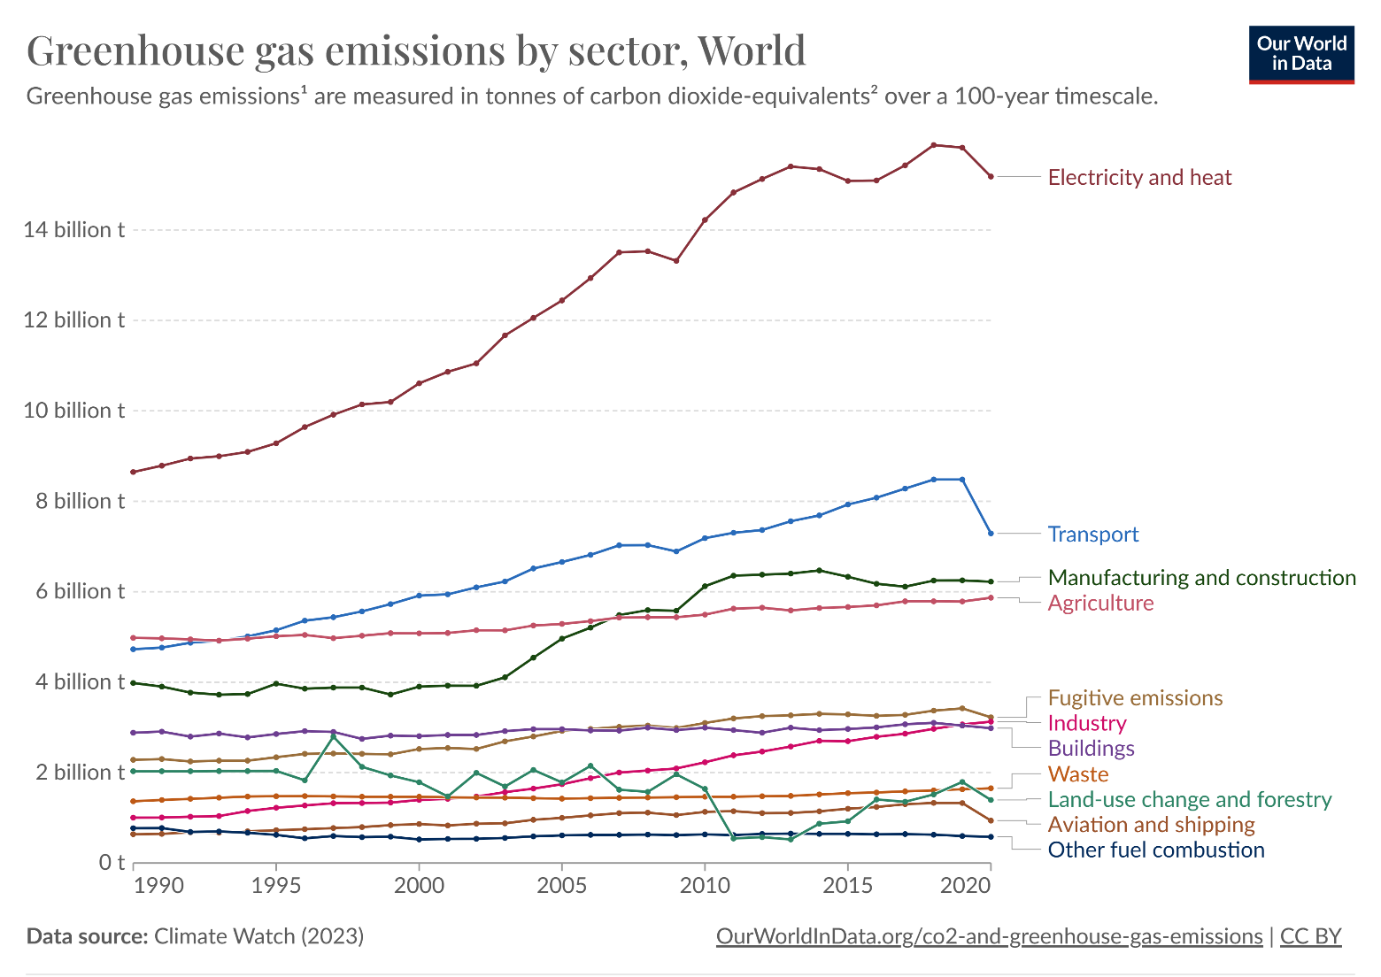

Slide 3
Energy conservation is the foundation of energy independence
—Tom Allen

Slide 4
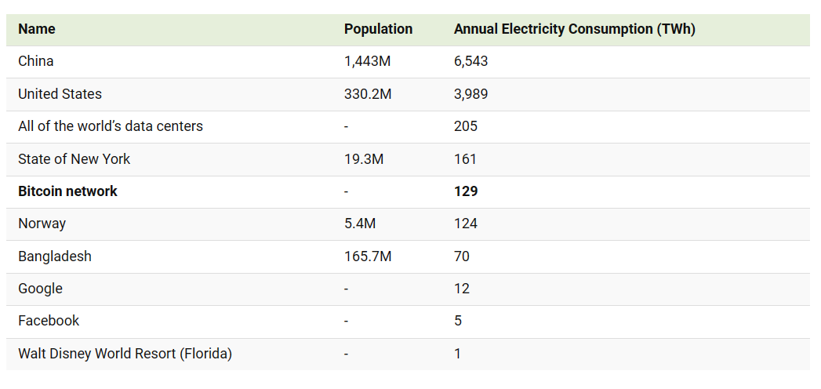
Energy Consumption by Sector

Slide 5
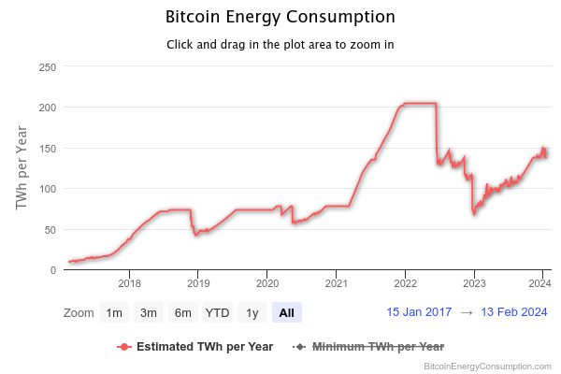

Slide 6
Consensus Mechanism
Core Problem
!
The Nakamoto Consensus that employs Proof Of Work

Slide 7
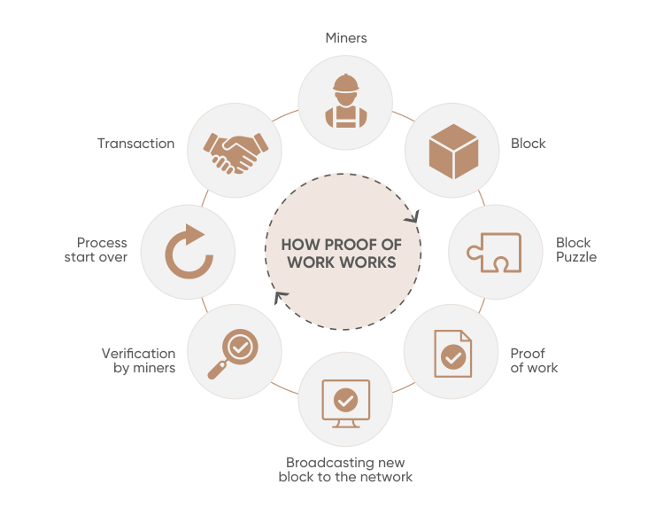

Slide 8

Proof Of Work

Slide 9
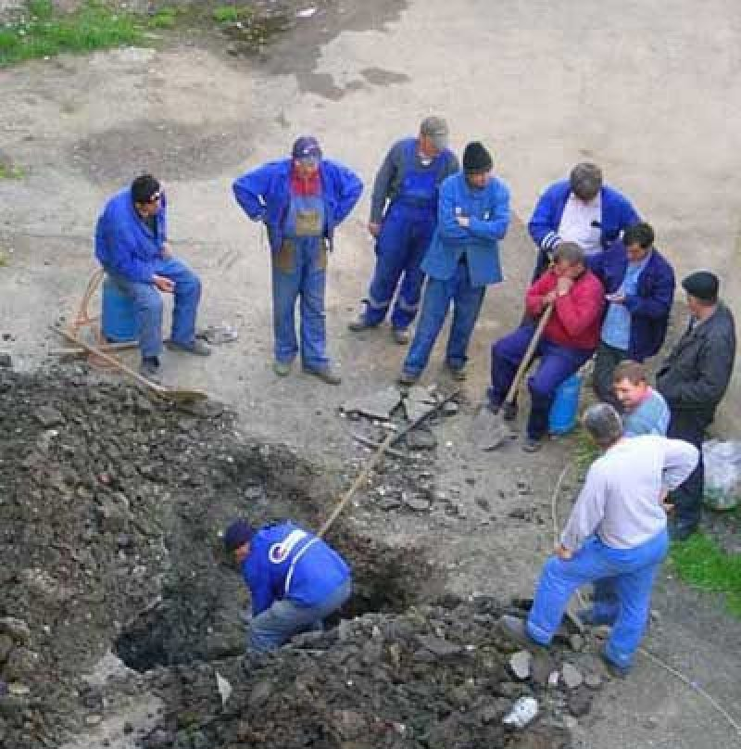
Proof Of Stake
Validator
Validator
Validator
Validator
Validator
Validator
Validator
Staker

Slide 10
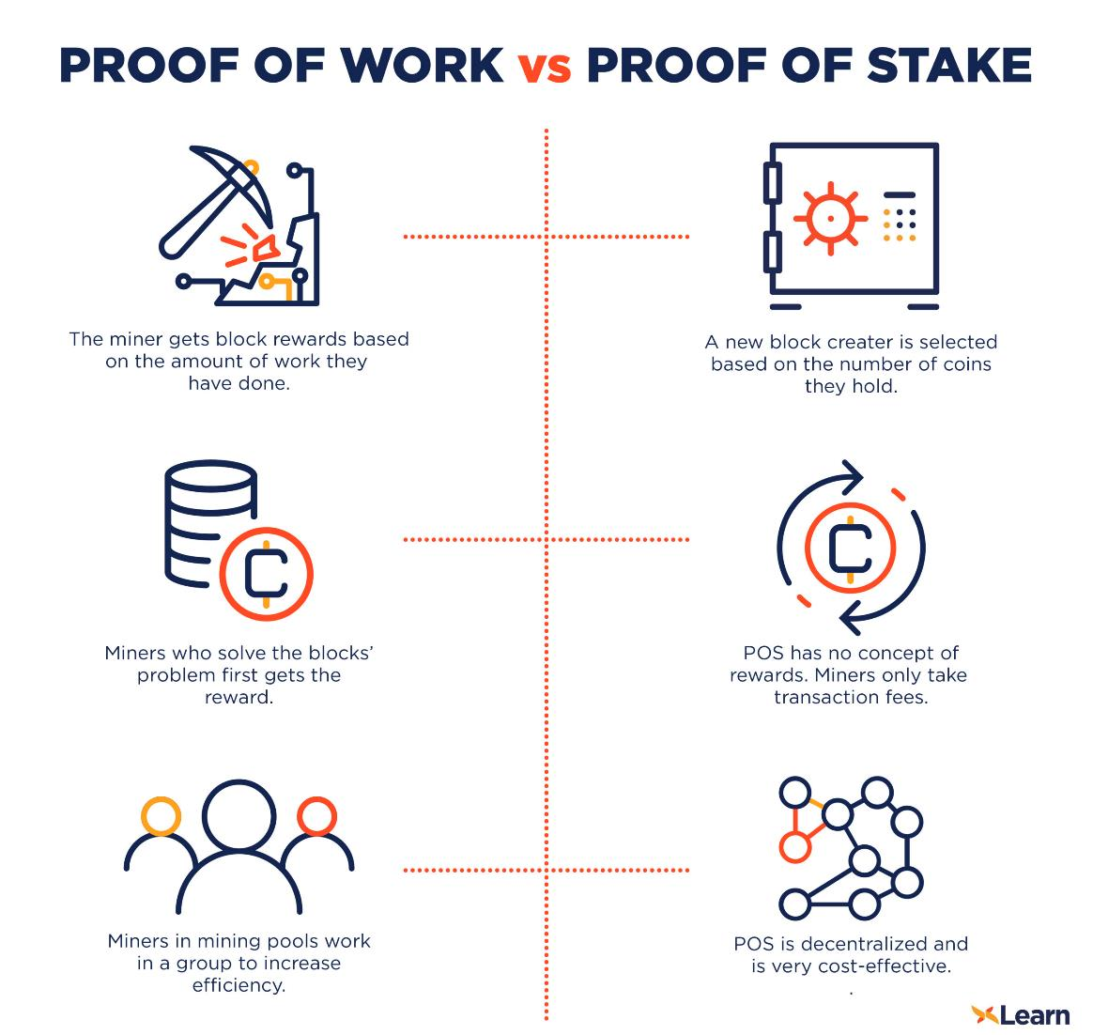

Slide 11
Reduction of Energy Consumption by switching from Proof Of Work to Proof Of Stake
99.98%

Slide 12
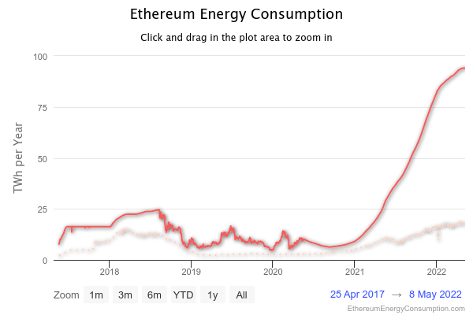

Slide 13
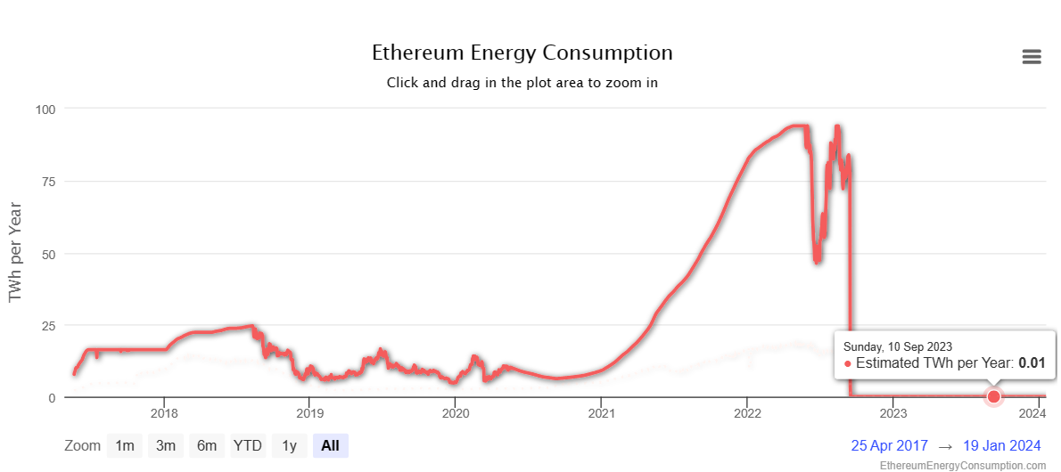
Ethereum switched from PoW to PoS on Sept. 15

Slide 14
EcoChain
Our mission
Provide Value Representation at Minimal Energy Consumption

Slide 15
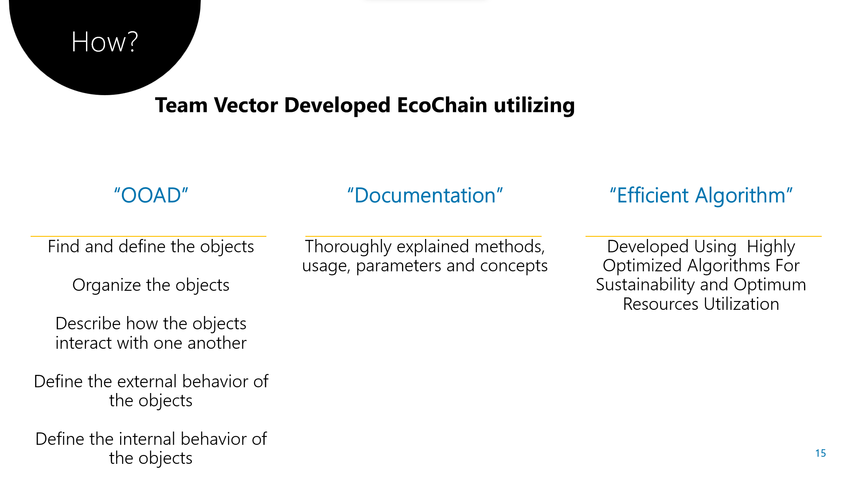

Slide 16
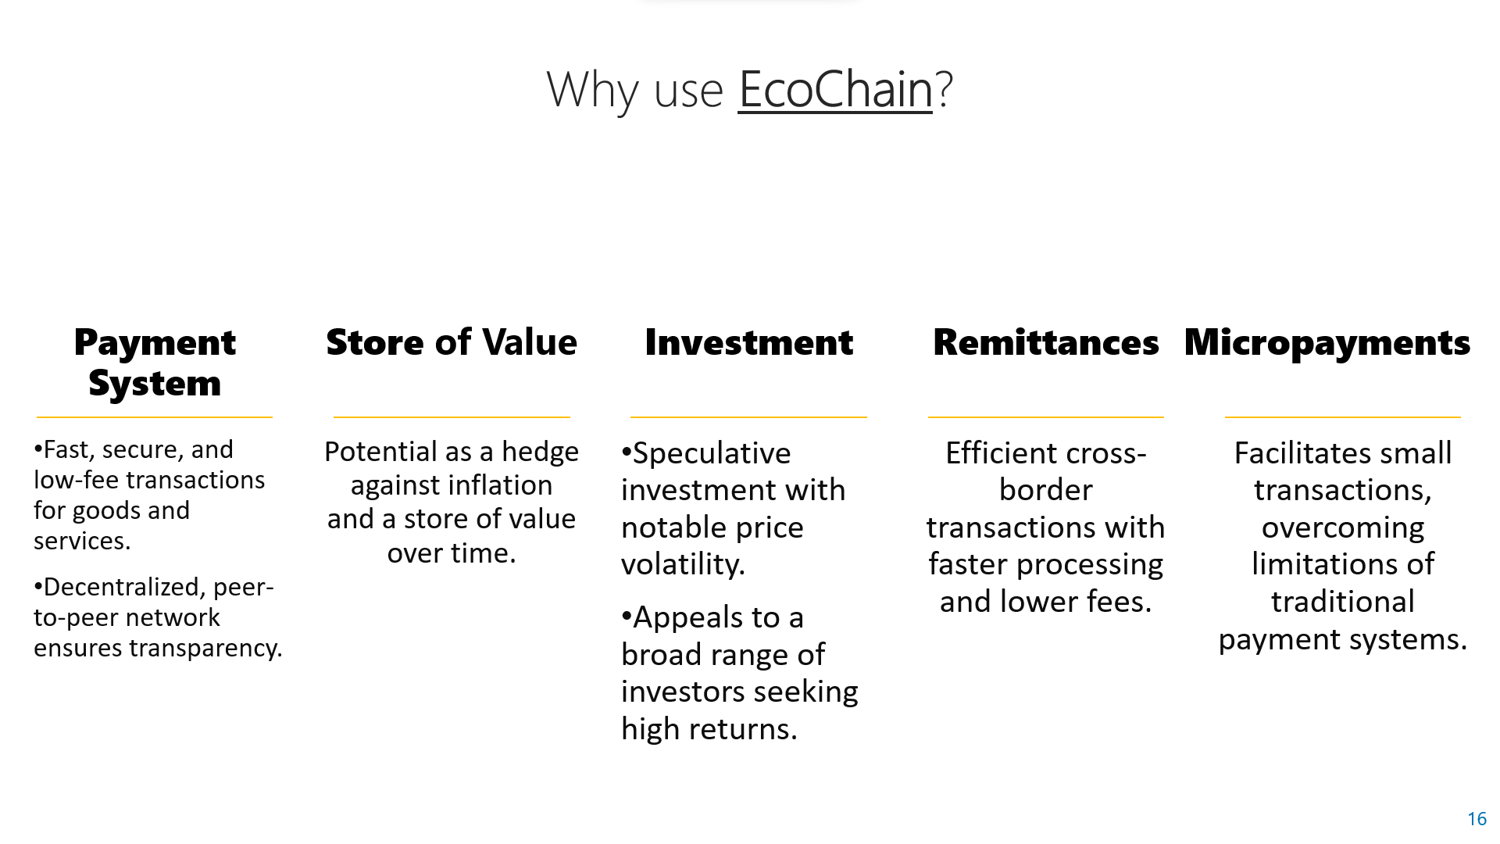

Slide 17
TEAM VECTOR!
THANK YOU

